Slide 1
Electrolyte/metabolic disturbance

Slide 2
Electrolyte and Metabolic Abnormalities

Slide 3
Potassium

Slide 4
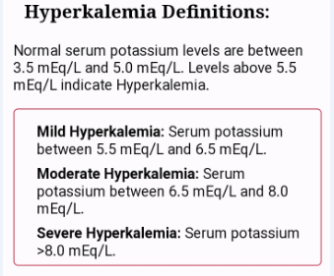

Slide 5
Hyperkalemia
The earliest effect usually is narrowing and peaking (or tenting) of the T wave.
The QT interval is shortened at this stage
The QRS begins to widen
P wave amplitude decreases.
PR interval prolongation

Slide 6
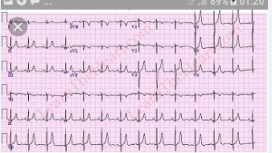

Slide 7
second- or third-degree atrioventricular block
Complete loss of P waves may be associated with a junctional escape rhythm or so-called sinoventricular rhythm.

Slide 8
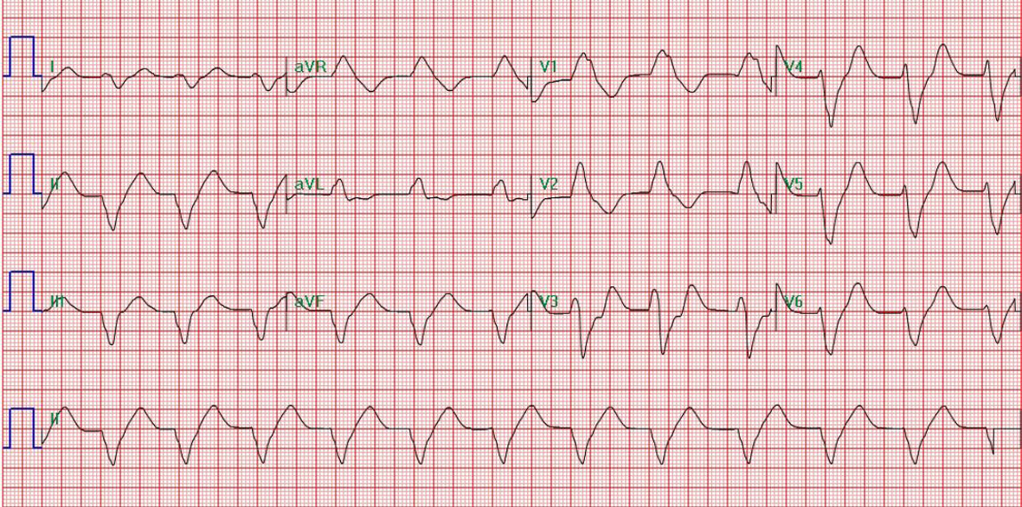

Slide 9
:Moderate to severe hyperkalemia
induces ST elevations in the right precordial leads (V1 and V2),
simulating an ischemic current of injuryor Brugada-type patterns.

Slide 10
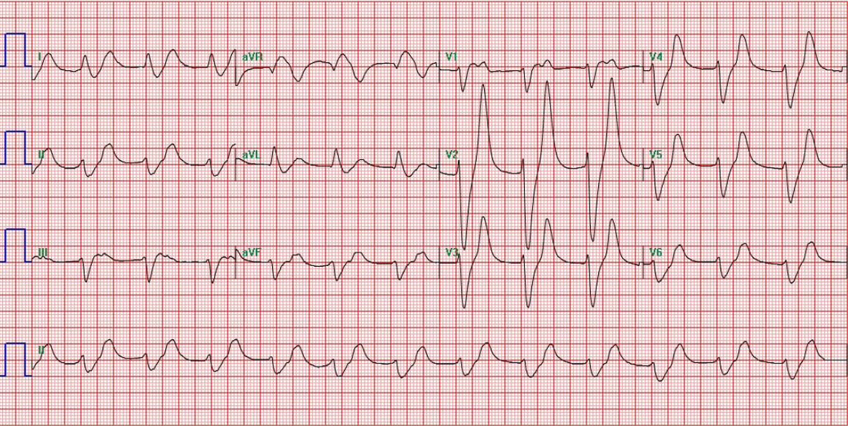

Slide 11
severe hyperkalemia
be associated with atypical or nondiagnostic
ECG findings.
Very marked hyperkalemia leads to eventual
asystole, sometimes preceded by a slow undulatory (or sine wave) ventricula flutterlike pattern

Slide 12
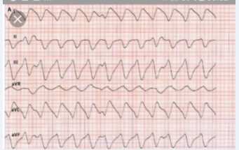

Slide 13
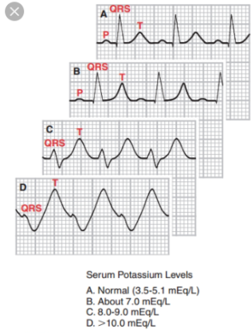

Slide 14
The ECG triadis strongly suggestive of chronic renal failure:
(1) peaked T waves (from hyperkalemia), (2) QT prolongation (from hypocalcemia), (3) LVH(from hypertension)

Slide 16
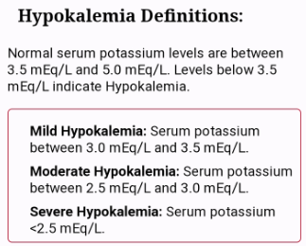

Slide 17
hypokalemia
The major ECG manifestations are
ST depression
flattened T waves
increased U wave prominence

Slide 19
Calcium

Slide 20
Hypercalcemia
An increased extracellular calcium concentration
shortens the ventricular action potential duration by shortening
phase 2 of the action potential.

Slide 21
Severe hypercalcemia (e.g., serum Ca2+ >15 mg/dL) :also can be associated with
decreased T wave amplitude,
sometimes with T wave notching or inversion. Hypercalcemia sometimes produces a
high takeoff of the ST segment in leads V1 and V2 and can thus simulate acute ischemia

Slide 23
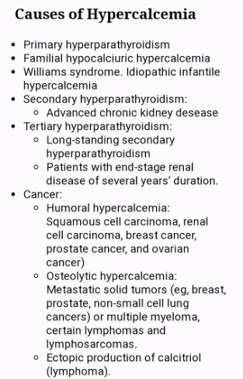

Slide 24
hypocalcemia
hypocalcemia prolongs phase 2 of the action potential. These cellular changes correlate with abbreviation and prolongation of the QT interval (ST segment )

Slide 26
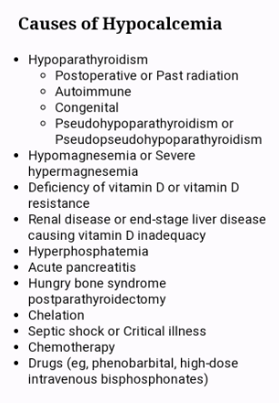

Slide 27
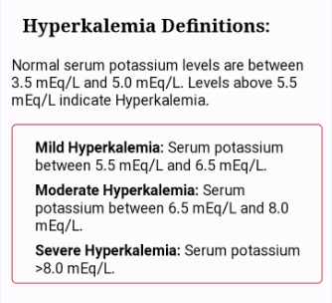

Slide 28
Magnesium
Specific electrocardiographic effects of mild to moderate isolated abnormalities in magnesium ion concentration are not well characterized.
.

Slide 29
Severe hypermagnesemia (serum Mg2+ >15 :mEq/L) can cause
atrioventricular and intraventricular conduction disturbances that may culminate in
complete heart block and cardiac arrest

Slide 30
Hypomagnesemia usually is associated with hypocalcemia or hypokalemia. Hypomagnesemia can potentiate certain digitalis toxic arrhythmias, and the role of magnesium deficiency in the pathogenesis
and treatment of the acquired long QT(U)
syndrome with torsades de pointes.

Slide 31
Isolated hypernatremia or hyponatremia does not produce consistent effects on the ECG.

Slide 32
hypothermia
hypothermia may be associated with the appearance of a distinctive convex elevation at the junction (J point) of the ST segment
and QRS complex (J wave or Osborn wave)

Slide 33
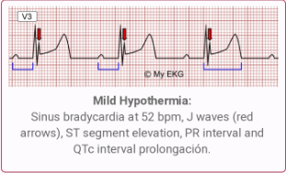

Slide 34
Thanks for your attention

