Slide 2
داروهای موثر بر سیستم قلبی وعروقی جدید در ایران

Slide 4
Aspirin
Clopidogrel
Dipyridamole
prasugrel

Slide 5
Prasugrel
Although prasugrel is also a prodrug that requires metabolic activation
its onset of action is more rapid than that of ticlopidine or clopidogrel,
and it produces greater and more predictable inhibition of ADP-induced platelet aggregation.
These characteristics reflect the rapid and complete absorption of prasugrel from the gut. Although all of absorbed prasugrel undergoes activation,
only 15% of absorbed clopidogrel undergoes metabolic activation

Slide 6
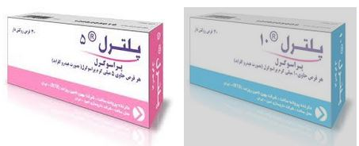
Dosing
After a loading dose of 60 mg, prasugrel is given
once daily at a dose of 10 mg.
Patients older than 75 years or weighing
less than 60 kg should receive a daily prasugrel dose of 5 mg.

Slide 7
Prasugrel was compared with clopidogrel in 13,608 patients with
acute coronary syndromes scheduled to undergo percutaneous coronary
intervention (PCI).
The incidence of the primary efficacy endpoint—a composite of cardiovascular death, myocardial infarction, and stroke—was significantly lower with prasugrel than with clopidogrel (9.9% and 12.1%, respectively), mainly because of a
reduction in the incidence of nonfatal myocardial infarction.
The incidence of stent thrombosis was also significantly lower with prasugrel
than with clopidogrel

Slide 8
Dipyridamole
A relatively weak antiplatelet agent
formulation of dipyridamole combined with low-dose aspirin, a preparation
marketed as Aggrenox, is used for prevention of stroke in patients with transient ischemic attacks

Slide 9
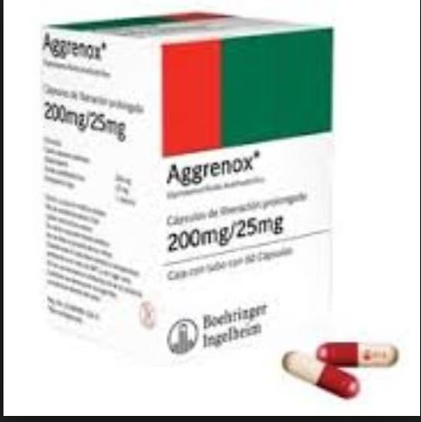
Dosing
Aggrenox is given twice daily.
Each capsule contains 200 mg of extended-release dipyridamole and 25 mg of aspirin.

Slide 10
Side Effects
Because dipyridamole has vasodilatory effects, caution is necessary
in patients with coronary artery disease.
Gastrointestinal complaints,
headache,
facial flushing,
dizziness
hypotension.
These symptoms often subside with continued use of the drug.

Slide 11
Anticoagulants
Heparin
Low-Molecular-Weight Heparin
Fondaparinux

Slide 12
Fondaparinux
A synthetic analogue of the antithrombin-binding pentasaccharide
sequence, fondaparinux differs from LMWH in several ways .
Fondaparinux is licensed for thromboprophylaxis in medical, general surgical, and high-risk orthopedic patients
an alternative to heparin or LMWH for the initial treatment of patients
with established VTE. Although fondaparinux is licensed as an alternative
to heparin or LMWH in patients with acute coronary syndrome
in Europe and Canada, it is not approved for this indication in the
United States.

Slide 13
PHARMACOLOGY OF FONDAPARINUX
Fondaparinux exhibits complete bioavailability after subcutaneous injection. With no binding to endothelial cells or plasma proteins,
clearance of fondaparinux is independent of dose and its plasma half-life is 17
hours. The drug is administered subcutaneously once daily.
Because of its renal clearance, fondaparinux is contraindicated in patients
with creatinine clearance lower than 30 mL/min, and it should be
used with caution in those with a creatinine clearance lower than
50 mL/min

Slide 14
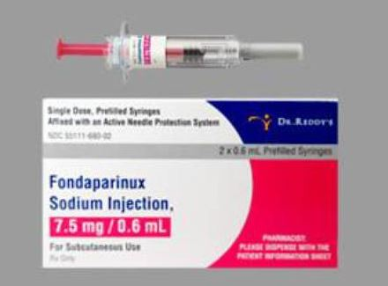
The drug is given at a dosage of 2.5 mg once daily for prevention of VTE.
For initial treatment of established VTE, fondaparinux is given at a dosage of 7.5 mg once daily.
The dosage can be reduced to 5 mg once daily for those weighing less than 50 kg and increased to 10 mg for those heavier than 100 kg

Slide 15
Side effect
The major side effect of fondaparinux is bleeding, and it has no
antidote. Protamine sulfate has no effect on the anticoagulant activity
of fondaparinux because it fails to bind to the drug.
Recombinant activated factor VII has reversed the anticoagulant effects of
fondaparinux in volunteers, but it is unknown whether this agent
controls fondaparinux-induced bleeding.

Slide 16
Direct Oral Anticoagulants
rivaroxaban
Dabigatran
Apixaban

Slide 17
Direct Oral Anticoagulants
Newer, direct oral anticoagulants that target thrombin or factor Xa
are now available as alternatives to warfarin. These drugs have a
rapid onset of action and half-lives that permit once- or twice-daily
administration.
Designed to produce a predictable level of anticoagulation,
the new oral agents are more convenient to administer than
warfarin because they are given in fixed doses without routine monitoring
of coagulation.

Slide 18
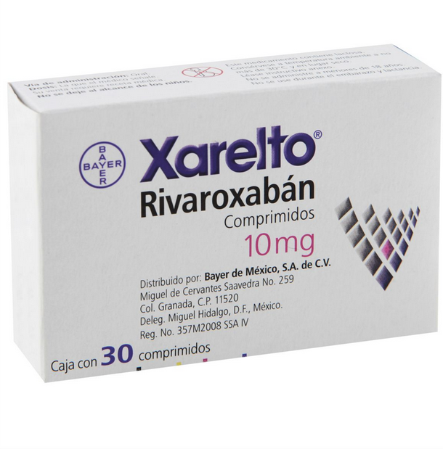
rivaroxaban
For prevention of stroke in patients with nonvalvular atrial fibrillation is given at a dosage of 20 mg once daily with a reduction to 15 mg once daily in patients with a creatinine clearance of 15 to 49 mL/min,
Rivaroxaban is licensed for thromboprophylaxis after elective hip, or knee replacement surgery and for the treatment of acute VTE.
For thromboprophylaxis, the dose is 10 mg once daily;
for treatment of VTE, the drug is started at a dose of 15 mg twice daily for 3 weeks and then reduced to 20 mg once daily thereafter.

Slide 19
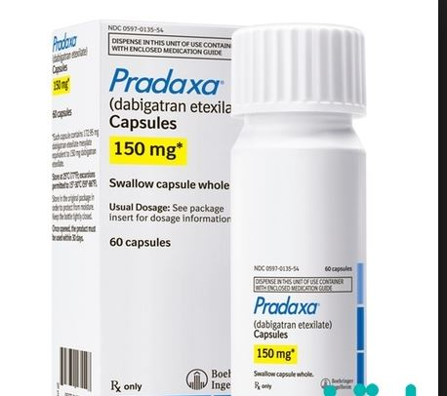
Dabigatran
Dabigatran is undergoing regulatory review for the treatment of VTE.
For this indication, patients must first receive a minimum of a 5-day course of a parenteral anticoagulant before starting dabigatran at a dosage of 150 mg twice daily.

Slide 20
Side Effects
Like any anticoagulant, bleeding is the most common side effect of the new oral anticoagulants.
Although the new agents are associated with less intracranial bleeding than warfarin is
the risk for gastrointestinal bleeding is higher with dabigatran and rivaroxaban than with warfarin.
Dyspepsia occurs in up to 10% of patients treated with dabigatran;
this problem improves with time and can be minimized by taking the drug with food

Slide 21
Periprocedural Management
Like warfarin, use of the new oral anticoagulants must be stopped before procedures associated with a moderate or high risk for bleeding.
The drugs should be withheld for 1 to 2 days or longer if renal function is impaired.

Slide 22
Management of Bleeding
The new oral anticoagulants have no specific antidotes.
With minor bleeding, withholding one or two doses of drug is usually sufficient.
With more serious bleeding, the approach is similar to that with warfarin except that vitamin K administration is of no benefit;
the anticoagulant and any antiplatelet drugs should be withheld,
the patient should be resuscitated with fluids and blood products as necessary,
and the bleeding site should be identified and managed.

Slide 23
Timing of the last dose of anticoagulant is important,
and oral activated charcoal may help prevent absorption of drug administered in the past 4 to 6 hours.
If bleeding continues or is lifethreatening, procoagulants, such as prothrombin complex concentrates (either unactivated or activated) or factor VIIa, can be
administered, although evidence of their effectiveness is limited.
Dialysis removes dabigatran from the circulation in patients with renal impairment; it does not remove rivaroxaban or apixaban because unlike dabigatran, they are highly protein bound

Slide 24
Pregnancy
As small molecules, the new oral anticoagulants can all pass through
the placenta. Consequently, these agents are contraindicated in pregnancy,
and when used by women of childbearing potential, appropriate
contraception is important.

Slide 25
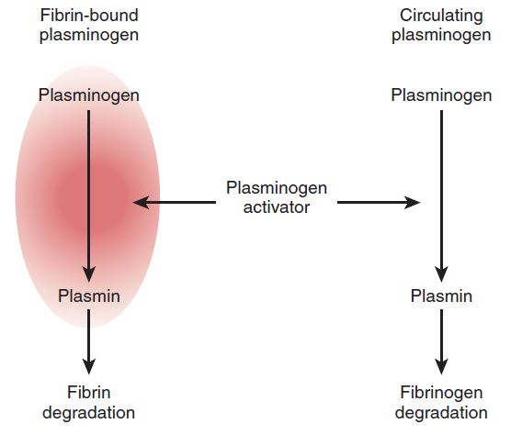
Fibrinolytic Drugs
Streptokinase
Alteplase
Reteplase

Slide 26
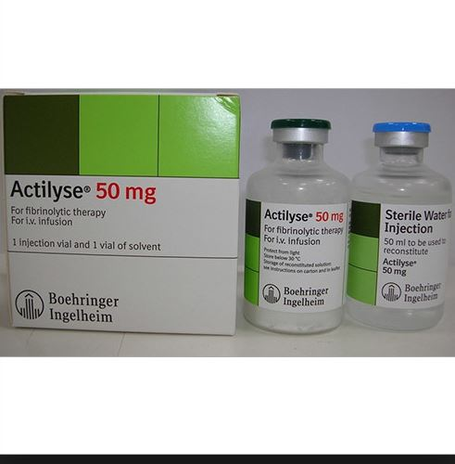
Alteplase
Acute myocardial infarction or acute ischemic stroke is
treated with an intravenous infusion of alteplase over a 60- to
90-minute period. The total dose of alteplase usually ranges from 90

Slide 27
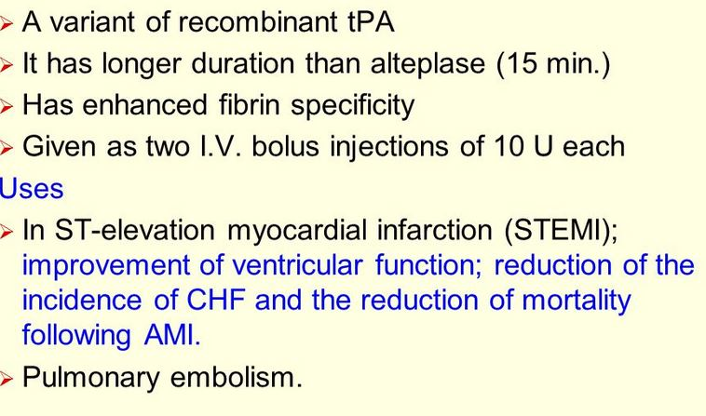
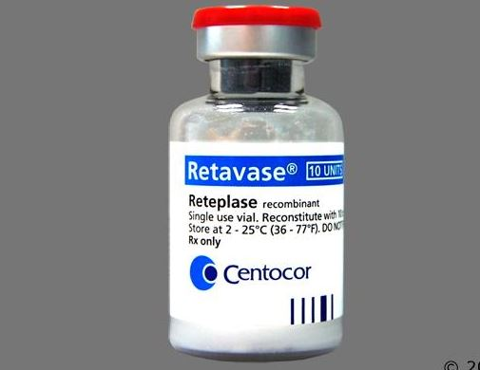
Reteplase

Slide 28
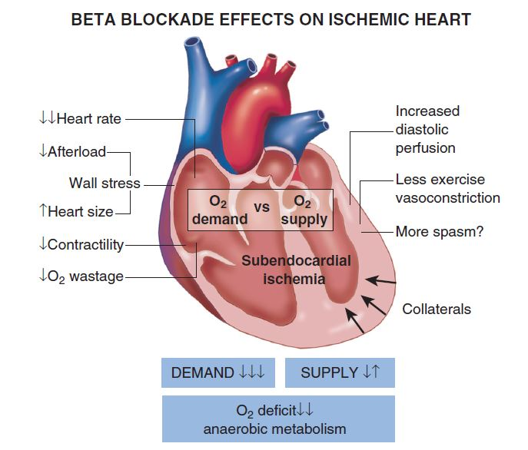
Beta Adrenoceptor–Blocking Agents

Slide 29
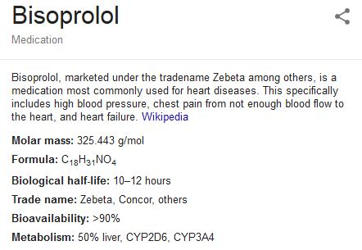
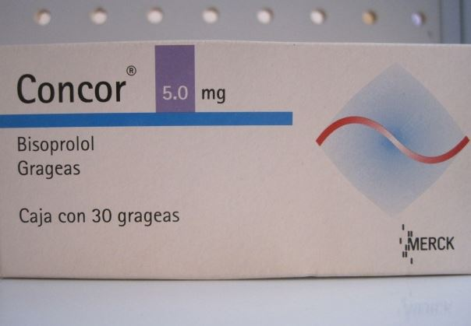

Slide 30
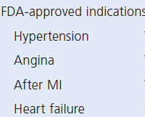

Slide 31
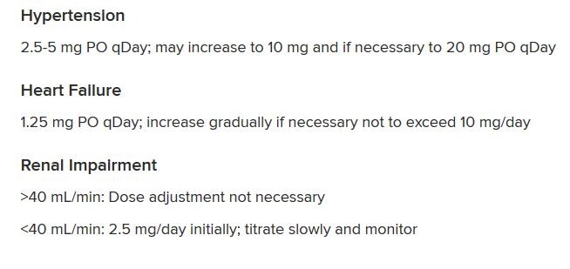

Slide 32
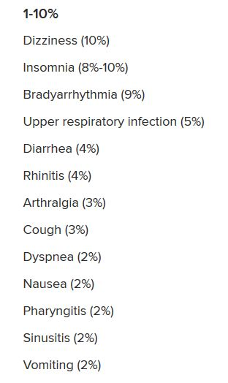
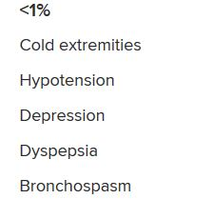

Slide 34
Metoprolol succinate

Slide 35
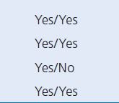

Slide 36
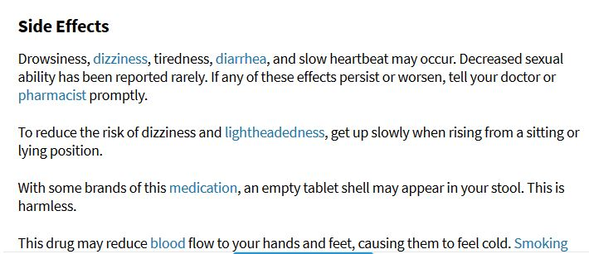

Slide 37
Diuretics
Indapamide
Metolazone

Slide 38
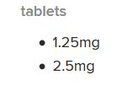
Indapamide

Slide 40
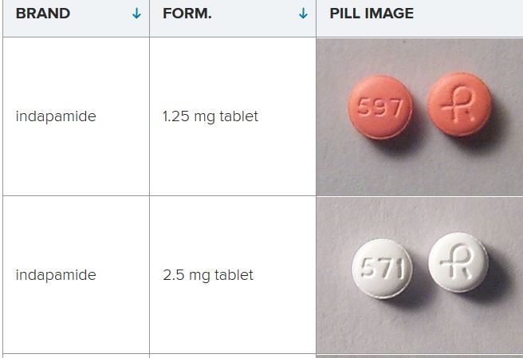

Slide 42
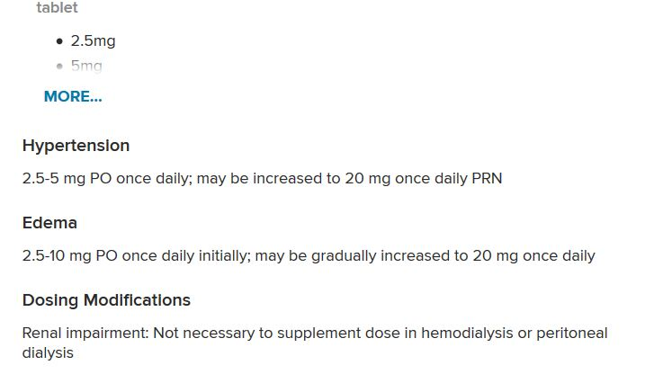
Metolazone

Slide 43
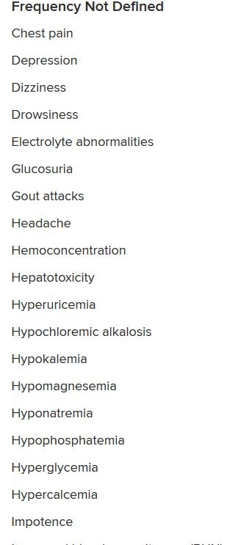

Slide 44
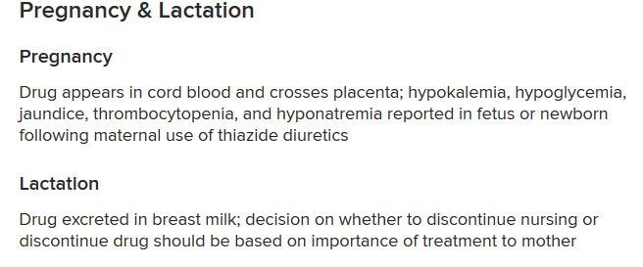

Slide 45
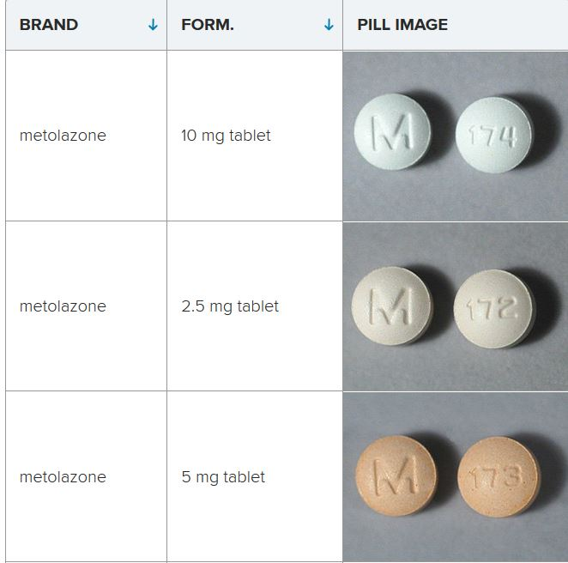

Slide 46
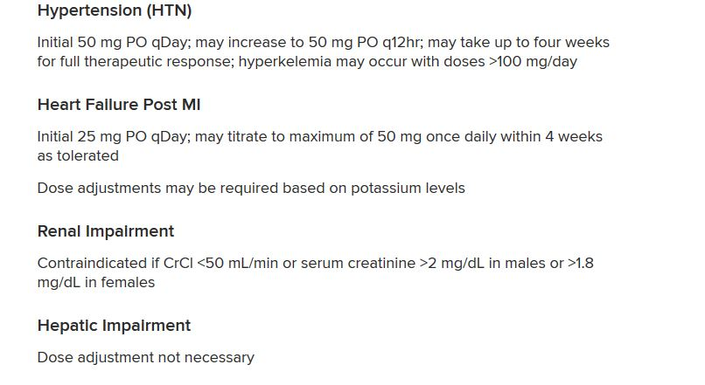
Eplerenone

Slide 49
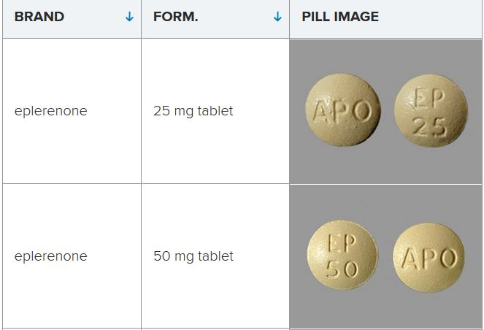

Slide 50
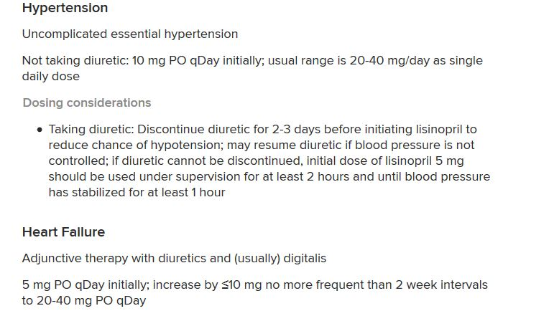
Lisinopril

Slide 51
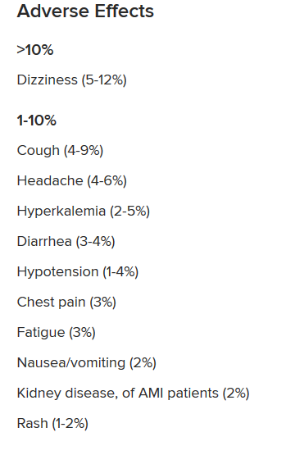

Slide 52
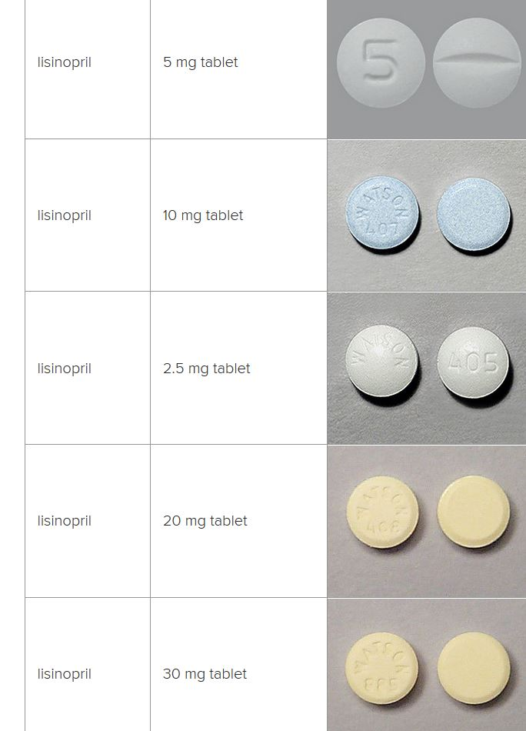

Slide 53
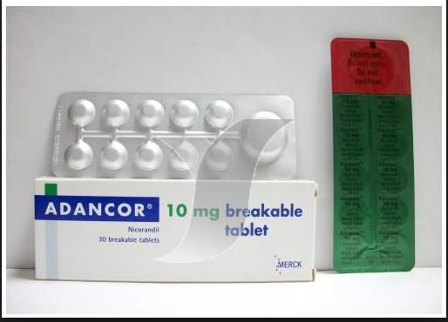
Nicorandil
Nicorandil is a nicotinamide ester that dilates peripheral and coronary resistance vessels As a result of these dual actions, nicorandil reduces preload and afterload and results in an increase in coronary blood flow.

Slide 54
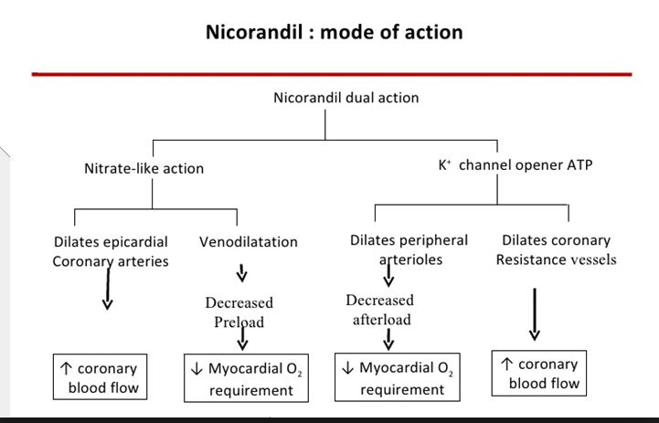

Slide 55
Nicorandil
Nicorandil has been associated with ulcerations of the gastrointestinal tract.
Nicorandil has antianginal efficacy similar to that of beta-blocking
agents, nitrates, and calcium channel–blocking agents.
nicorandil reduced the risk for cardiac death, MI, or hospital admission for angina

Slide 56
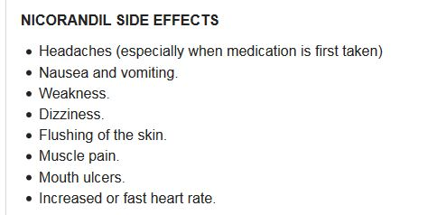

Slide 57
Thanks for your attention

